Slide 1
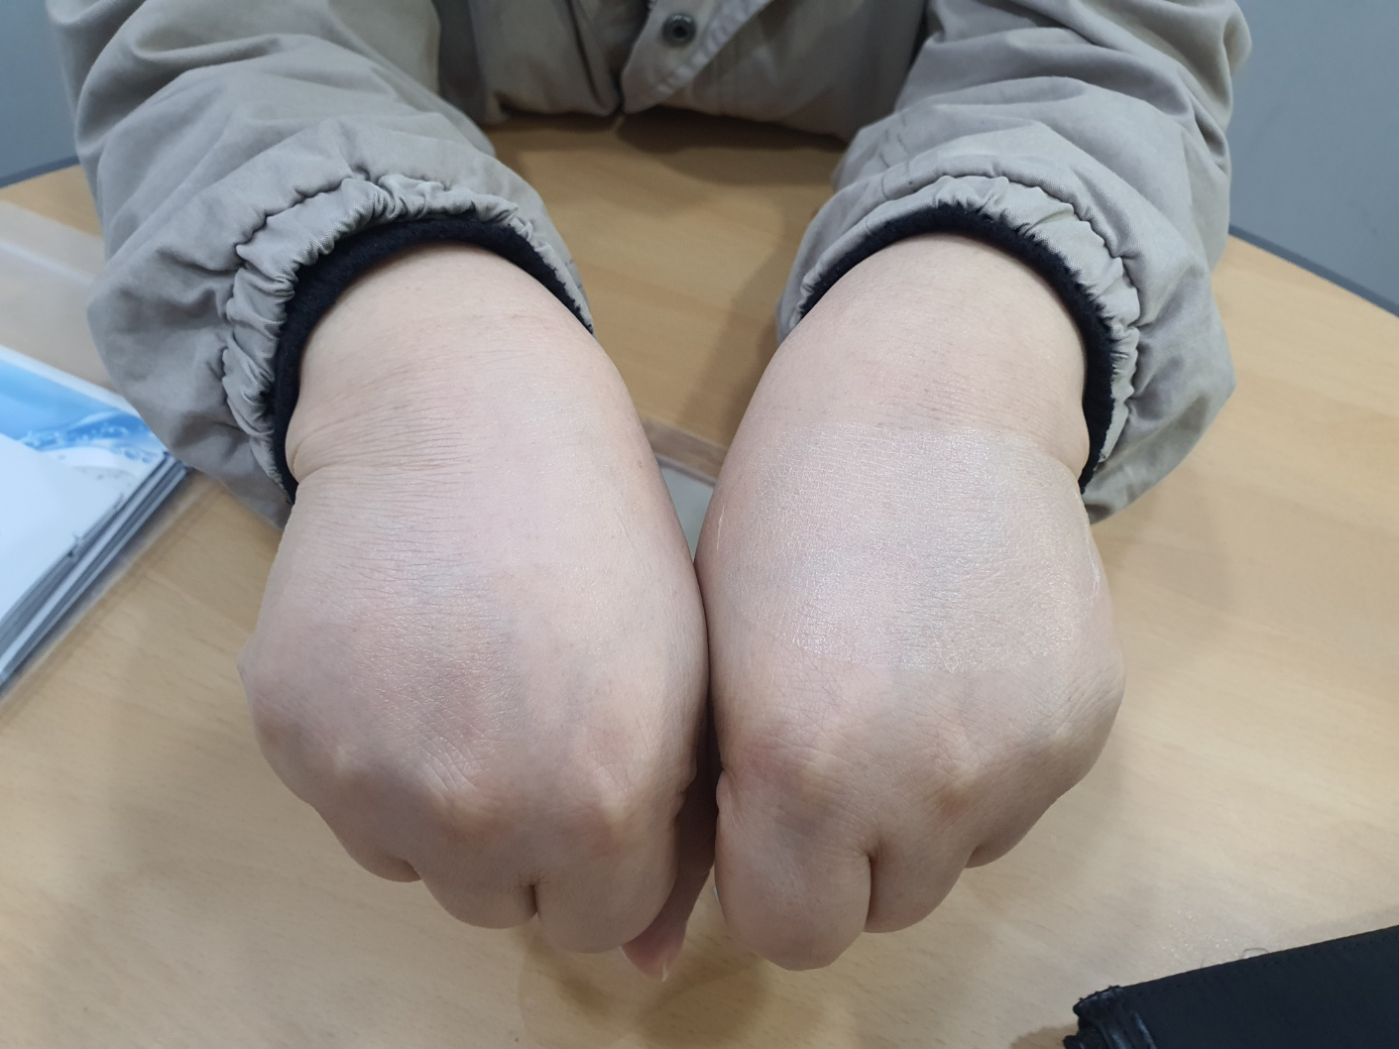
Our Skin Nude Sun shield after make up can not see any patch. Our products are invisible after makeup and has a matte texture and is not shiny. Once attached, the edges of our product will not tear.When removing our product, it comes off in one go.
F214 GoYang ArchBiz Center , #63 Sam Won-Ro, Deok Yang Gu
GoYang City, Kyung Gi Do, South of KOREA ( 10550 )
Tel : +82 707 674 2757 Fax : +82 505 300 2757
Email : info@vbkorea.kr
Website: https://www.vbkorea.kr
This product is from another brand company.
Like our product,
it is advertised as a nude sun patch, but the product is clearly visible after makeup.
Can you see our sun Patch ?

Slide 2
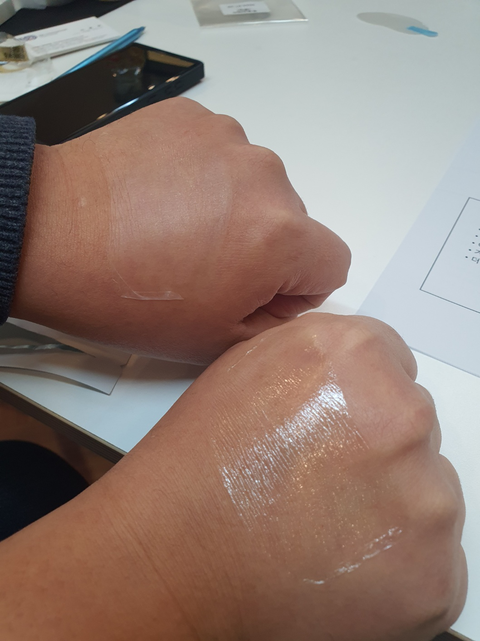
Our nude skin is made of matte material and does not sparkle.
F214 GoYang ArchBiz Center , #63 Sam Won-Ro, Deok Yang Gu
GoYang City, Kyung Gi Do, South of KOREA ( 10550 )
Tel : +82 707 674 2757 Fax : +82 505 300 2757
Email : info@vbkorea.kr
Website: https://www.vbkorea.kr
Products from other brands have a shiny surface and are easily exposed after makeup.

Slide 3
Our products do not sweat during strenuous exercise or come off during showering.
F214 GoYang ArchBiz Center , #63 Sam Won-Ro, Deok Yang Gu
GoYang City, Kyung Gi Do, South of KOREA ( 10550 )
Tel : +82 707 674 2757 Fax : +82 505 300 2757
Email : info@vbkorea.kr
Website: https://www.vbkorea.kr
When removing our patches, they come off in one go without any breaks in between.
Play video
Play video

